Slide 1
1 Dollar 1 Hour
A video game evaluator

Slide 2
Problem Statement
Video game databases provide all sorts of useful information such as the title, publisher, developer, genre, platform, price, rating, and sales number.
What I’ve noticed is that these databases lack the price of a game, average play time, and replay value
That and some gamers want to know if their money is well spent. Hence the phrase “1 Dollar 1 Hour”
What I aim to do is calculate whether a game’s price is equivalent to the hours of content it can provide

Slide 3
Background
VGCharts (vgchartz.com)
Video game database that focuses on listing the sales numbers of both video game software and hardware
Metacritic (metacritic.com/games)
The games section of this multifaceted database focuses mostly on a games rating among both critics and users
HowLongToBeat (howlongtobeat.com)
Provides game play times of all the games in it’s community.

Slide 4
Service Overview
User input
Video game title
When user initiates search
Pulls up average play time from a database
Pulls up the MSRP of the game from a database
Pulls up the rating of the game from a database
Calculate and display 1 Dollar 1 Hour score
Positive number (green text) means you are above threshold
Negative number (red text) means you are below the threshold
Calculate and display its dollar per hour value
Calculate and display replay value
Calculate number of times to play to achieve 1 dollar 1 hour

Slide 5
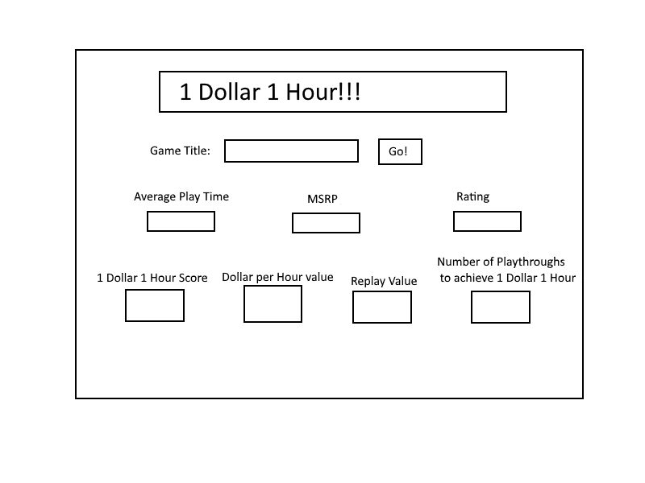
Mock Up

